Slide 1

CLIENT SERVER PROGRAMMING USING DUAL STACK (IPv4 and IPv6) HOST
Batch Details : Batch 16
Name USN
S Bharath 1NT18EC134
Shaik Abdul Aleem 1NT18EC143
Likith N 1NT18EC083
Rizwan Khan 1NT18EC130
Project Supervisor
Prof. Sitaram Yaji
Professor Dept. of Electronics and Communication Engineering
Nitte Meenakshi Institute of Technology Yelahanka, Bangalore-560064

Slide 2
Presentation Outline
Brief Introduction
Literature Survey
Research Gap Analysis/Drawbacks in Existing Systems
Project Objectives
References

Slide 3
Introduction
The internet can be accessible worldwide which is system of interconnected networks. Two current versions of the Internet Protocol (IPv4 and IPv6 ) are provided by Internet Assigned Numbers Authority (IANA).
IPv4 protocol was already allotted to Regional Internet Registries (RIR) and there is no more IPv4 address to allot and IANA has started issuing the IPv6 address to RIR. In February 2011, all IPv4 addresses had vanished and now we are going for IPv6.
Therefore several mechanisms are required which ensures smooth, stepwise an independent change to IPV6. Not only is the transition, integration of IPv6 is also required into the existing networks.
The solutions (or mechanisms) can be divided into three categories: dual stack, tunneling and translation.
Dual-stack is a preferred, most versatile way to deploy IPv6 in existing IPv4 environments.

Slide 4
Literature Survey
Title | Author Name | Citation | Algorithms/Techniques | Conclusion
Migration to Ipv6 from IPV4 by dual stack | S. Aravind; G. Padmavathi | S. Aravind and G. Padmavathi, "Migration to Ipv6 from IPV4 by dual stack and tunneling techniques," 2015 International Conference on Smart Technologies and Management for Computing, Communication, Controls, Energy and Materials (ICSTM), 2015, pp. 107-111, doi: 10.1109/ICSTM.2015.7225398. | Dual Stack Protocol - transferring of data from IPv4 network to IPv6 network in both static and dynamic routing | Dynamic IPv4 has least minimum & average round trip delay and Dynamic IPv6 has least maximum round trip delay.
Implementation of IPv6 Over IPv4 Using Dual Stack Transition Mechanism (DSTM) on 6iNet
Moving from Internet Protocol version Four (IPv4) to Internet Protocol version six (IPv6) is not straightforward because IPv4 and IPv6 are incompatible protocols.
To enable the smooth integration between IPv4 and IPv6, several transition mechanisms have been proposed by IETF IPng Transition Working Group (NGTrans). One of them is Dual Stack Transition Mechanism (DSTM).
The DSTM architecture is consist of three (3) parts. They are the client (using FreeBSD and Linux as an operating system), the server and the DSTM gateway or called tunnel end-point router (TEP).

Slide 5
Title | Author Name | Citation | Algorithms/Techniques | Conclusion
Performance comparison of Multimedia Applications over IPv4 and IPv6 Dual Stack technology | Ummi Suraya Shaharuddin; Ruhani Ab Rahman; Murizah Kassim; Mat Ikram Yusof | Ummi Suraya Shaharuddin, R. Ab Rahman, M. Kassim and M. I. Yusof, "Performance comparison of Multimedia Applications over IPv4 and IPv6 Dual Stack technology," 2016 6th International Conference on System Engineering and Technology (ICSET), 2016, pp. 1-6, doi: 10.1109/ICSEngT.2016.7849613. | RIPv2 routing protocol for both GNS3 simulation and Cisco hardware routers | IPv6 is better compared to IPv4 through Dual Stack protocol. Multimedia streaming data analysis proved that IPv6 is faster than IPv4 transmission with Dual stack protocol.

Slide 6
Title | Author Name | Citation | Algorithms/Techniques | Conclusion
Implementation and Test of PMIPv6 Dual Stack Protocol | Fei Ren; Huachun Zhou | F. Ren and H. Zhou, "Implementation and Test of PMIPv6 Dual Stack Protocol," 2012 Sixth International Conference on Innovative Mobile and Internet Services in Ubiquitous Computing, 2012, pp. 305-310, doi: 10.1109/IMIS.2012.67. | Proxy Mobile IPv6 Dual Stack, which is easy, dynamic, scalable, and manageable, enabling the integration of IPv4 and IPv6. | Proxy Mobile IPv6 Dual Stack technology allows mobile node which supports dual stack protocol to communicate through IPv6 or IPv4 network and resolves the problem of migrating from IPv4 to IPv6. Proxy Mobile IPv6 Dual Stack technology does not introduce more delay by expanding relevant models.

Slide 7
Title | Author Name | Citation | Algorithms/Techniques | Conclusion
Performance analysis of Mobile IPv6 support for Dual Stack hosts | Bruno Faria; Eduardo Souto | B. Faria and E. Souto, "Performance analysis of Mobile IPv6 support for Dual Stack hosts," 2014 IEEE/ACS 11th International Conference on Computer Systems and Applications (AICCSA), 2014, pp. 92-100, doi: 10.1109/AICCSA.2014.7073184. | Dual Stack Mobile IPv6 as a mobility management solution for dual stack nodes to roam between different IPv4 and IPv6 networks | Performance metrics as binding management signaling cost, session disruption time, average packet loss and packet delivery cost were carefully derived according to handoff scenarios, user mobility and traffic patterns.

Slide 8
Title | Author Name | Citation | Algorithms/Techniques | Conclusion
Measuring TCP connection establishment times of dual-stacked web services | Vaibhav Bajpai ; Jürgen Schönwälder | V. Bajpai and J. Schönwälder, "Measuring TCP connection establishment times of dual-stacked web services," Proceedings of the 9th International Conference on Network and Service Management (CNSM 2013), 2013, pp. 130-133, doi: 10.1109/CNSM.2013.6727822. | The happy program, a simple TCP happy eyeballs probing tool, is the implementation of metric. | Connection establishment times over IPv6 were higher.

Slide 9
Title | Author Name | Citation | Algorithms/Techniques | Conclusion
IPv4 versus IPv6 - who connects faster? | Vaibhav Bajpai; Jürgen Schönwälder | V. Bajpai and J. Schönwälder, "IPv4 versus IPv6 - who connects faster?," 2015 IFIP Networking Conference (IFIP Networking), 2015, pp. 1-9, doi: 10.1109/IFIPNetworking.2015.7145323. | Metric that measures the time taken to establish a TCP connection to a given endpoint. The input parameter of the metric is a tuple (service name, port number) and the output is the TCP connection establishment time for all endpoints the service(The Happy tool) | Multiple websites are served from CDN(content delivery network) caches deployed within access networks. We also witnessed cases where these CDN caches were present for IPv4, but were largely absent for IPv6 leading to relatively higher TCP connection establishment times.

Slide 10
Title | Author Name | Citation | Algorithms/Techniques | Conclusion
The NAT64/DNS64 tool suite for IPv6 transition | Marcelo Bagnulo; Alberto Garcia-Martinez; Iljitsch Van Beijnum | M. Bagnulo, A. Garcia-Martinez and I. V. Beijnum, "The NAT64/DNS64 tool suite for IPv6 transition," in IEEE Communications Magazine, vol. 50, no. 7, pp. 177-183, July 2012, doi: 10.1109/MCOM.2012.6231295. | NAT64 (NAT-Network Address Translation)translates IPv6 packets into IPv4 packets and vice versa. Binding Information Base, Session Table, DNS64 synthesizes AAAA resource records (AAAA RRs) from A resource records (A RRs) | The DNS64/NAT64 manages explicitly only communications initiated from the IPv6 side. DNS64 is a full-fledged architectural component that is part of a DNS resolver, As such, it does not need to transparently intercept DNS queries. DNS64/NAT64 uses by default the Well-Known Prefix that allows having a globally valid IPv6 representation of an IPv4 address.

Slide 11
Title | Author Name | Citation | Algorithms/Techniques | Conclusion
IPv4 to IPv6 Migration and Performance Analysis using GNS3 and Wireshark | Ravi Kumar CV ; Hrithik Goyal | R. K. CV and H. Goyal, "IPv4 to IPv6 Migration and Performance Analysis using GNS3 and Wireshark," 2019 International Conference on Vision Towards Emerging Trends in Communication and Networking (ViTECoN), 2019, pp. 1-6, doi: 10.1109/ViTECoN.2019.8899746.

Slide 12
Implementation of IPv6/IPv4 Dual-Stack Transition Mechanism
With the rapid development of Internet, IPv4 protocol can no longer meet the needs of users. This is mainly due to the limitations of IPv4 in terms of addresses, routing and security.
Correspondingly, IPv6 has the advantage of large address space, security, mobility, quality of service and so on. So IPv6 protocol has become the inevitable trend of network development. However IPv4 and IPv6 are incompatible protocols, so a solution to transition is required.
In order to achieve smooth and stepwise transition, IETF recommends three kinds of transition mechanisms: dual stack, tunneling and translation technology.

Slide 13
IPv4 to IPv6 Migration and Performance Analysis using GNS3 and Wireshark
The IPv4 protocol is not particularly efficient in its use of the available space, with many addresses being wasted. The internet authorities started to predict address exhaustion in the late 1980s and IPv6 was developed in the 1990s as the long-term solution.
Dual-Stack Transition Technique :IPv4 and IPv6 do not have to be an ‘either or’ decision. In a dual stack implementation, a network interface can have both an IPv4 and IPv6 address at the same time. It can communicate using either of the protocol available.
Design and Configuration of the Dual-Stack Transition Technique Dual stack is designed to support both the IPv4 and IPv6 addresses on the same network interface, thereby allowing the data to transfer from IPv4 network to IPv6 network using both static and dynamic routing.
The network consists of five routers, two Ethernet switches, and four end hosts. All router interfaces, as well as the hosts, have been configured with an IPv4 address as well as with an IPv6 address. The network can then communicate using either protocol.

Slide 14
Basic Architecture
Three Hosts on LAN
Host1 IPv4/IPv6 (LAN interface should have both IPv4 and IPv6 addresses)
Host 2 IPv4
Host 3 IPv6
Host 1 -
One server for NMIT seminar hall booking application (using IPv4)
Second server for application - NMIT IP IVR (interactive voice response) system (using IPv6)
Both servers will be running at the same time
Host 2
One client for NMIT seminar hall booking application (using IPv4)
Host 3
One client for application - NMIT IP IVR(interactive voice response) system (using IPv6)

Slide 15
Tools Required
Two Linux desktops/laptops, One Raspberry Pi board
C or Python
Socket programming
Software development for Applications
GDB and Wireshark tool may be used during testing / debugging

Slide 16
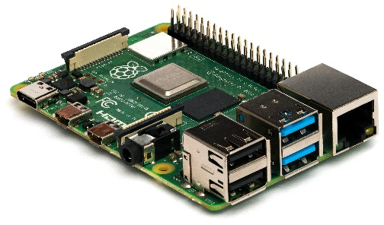
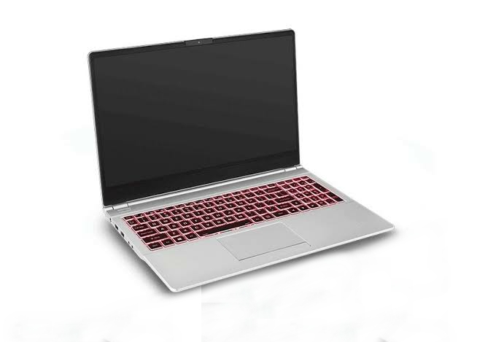
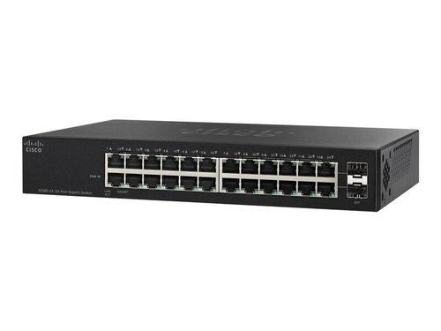
Three Hosts on LAN
Raspberry Pi
(IPv6 only)
Switch
Dual Stack Host (IPv4 and IPv6)
Linux System
(IPv4 only)
Note : Works for WAN also

Slide 17
Tools

Slide 18
Project Objectives
The following are the proposed objectives of the project based on the research gaps:
To Implement client server programming on dual stack host
Dual stack host running two server programs Ipv4 client (VoIP, udp) Ipv6 client (data application/TCP)
Both clients contacting dual stack host at the same time
Desktop/Laptop and Raspberry Pi boards will be used for establishing Communication

Slide 19
References
R. K. CV and H. Goyal, "IPv4 to IPv6 Migration and Performance Analysis using GNS3 and Wireshark," 2019 International Conference on Vision Towards Emerging Trends in Communication and Networking (ViTECoN), 2019, pp. 1-6, doi: 10.1109/ViTECoN.2019.8899746
J. Hyun, J. Li, H. Kim, J. Yoo and J. W. Hong, "IPv4 and IPv6 performance comparison in IPv6 LTE network," 2015 17th Asia-Pacific Network Operations and Management Symposium (APNOMS), 2015, pp. 145-150, doi: 10.1109/APNOMS.2015.7275417.
S. Aravind and G. Padmavathi, "Migration to Ipv6 from IPV4 by dual stack and tunneling techniques," 2015 International Conference on Smart Technologies and Management for Computing, Communication, Controls, Energy and Materials (ICSTM), 2015, pp. 107-111, doi: 10.1109/ICSTM.2015.7225398.
Hatim Mohamad tahir,Azman Taa,Norshakinah Bt. Md. Nasir, “Implementation of IPv6 Over IPv4 Using Dual Stack Transition Mechanism (DSTM) on 6iNet” Universiti Utara Malaysia, December 2014
Niranjan Ravi, Muppidathi Saravanan A, Manoranjan Periyasamy, Niraj Prasad Bhatta “Implementation of IPv6/IPv4 Dual-Stack Transition Mechanism”, Jain University, November 2014

